Slide 1
Statistics in Data Science

Slide 2
Topics
Distributions
Gaussian/Normal Distribution
Bernoulli Distribution
Bionomial Distribution
Pareto Distribution
Log Normal Distribution
Poisson Distribution
F test
Central Limit Theorem

Slide 3
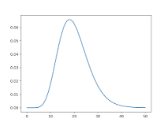
Why Distributions?
What is the purpose of distributions?
The distribution provides a parameterized mathematical function that can be used to calculate the probability for any individual observation from the sample space. This distribution describes the grouping or the density of the observations, called the probability density function

Slide 4
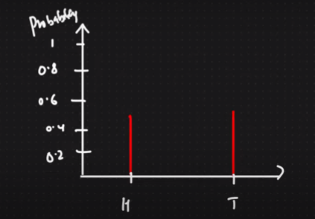
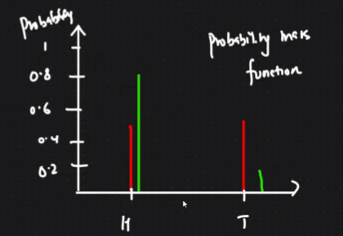
Bernoulli’s Distribution
It is the discrete probability distribution of a random variable which takes the value 1 with probability (p and the value 0 with probability q=1-p.
Probability Mass Distribution is for categorical variables.

Slide 5
Binomial Distribution
Mixture of multiple bernoulli distribution
The binomial distribution with parameters n and p is the discrete probability distribution of the number of successes in a sequence of n independent experiments, each asking a yes–no question, and each with its own Boolean-valued outcome: success (with probability p) or failure (with probability q=1-p)
Notation:
B(n,p)
n= number of trials
p=success probability of each trial

Slide 6
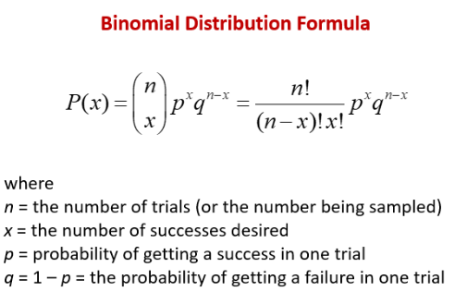

Slide 7
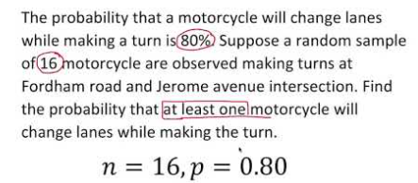
Question for practice

Slide 8
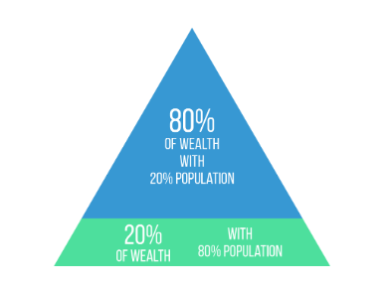
Pareto Distribution

Slide 9
Pareto distribution
It is a power-law probability distribution that is used in description of social, quality control, scientific, geophysical, actuarial, and many other types of observable phenomena.
The Pareto principle or "80-20 rule" stating that 80% of outcomes are due to 20% of causes was named in honour of Pareto

Slide 10
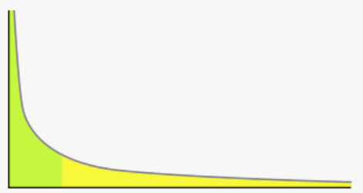
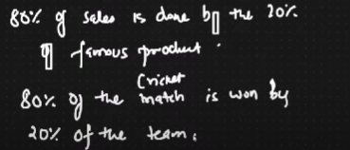
Power Law
The power law (also called the scaling law) states that a relative change in one quantity results in a proportional relative change in another.

Slide 11
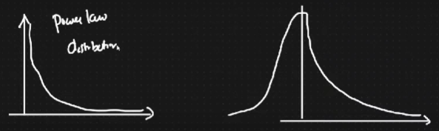
Transformation

Slide 12
Log Normal Distribution
A lognormal distribution is a continuous probability distribution of a random variable in which logarithm is normally distributed.
If ln(X) is normally distributed, then it is a log normal distribution.
Thus, if the random variable has a lognormal distribution, then has a normal distribution. Likewise, if has a normal distribution, then has a lognormal distribution

Slide 13
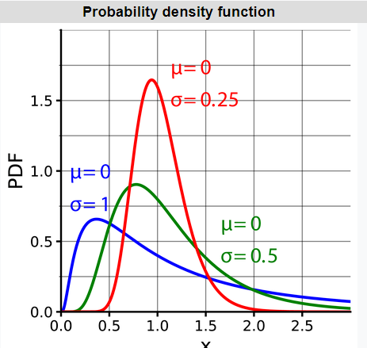
Log Normal Distribution

Slide 14
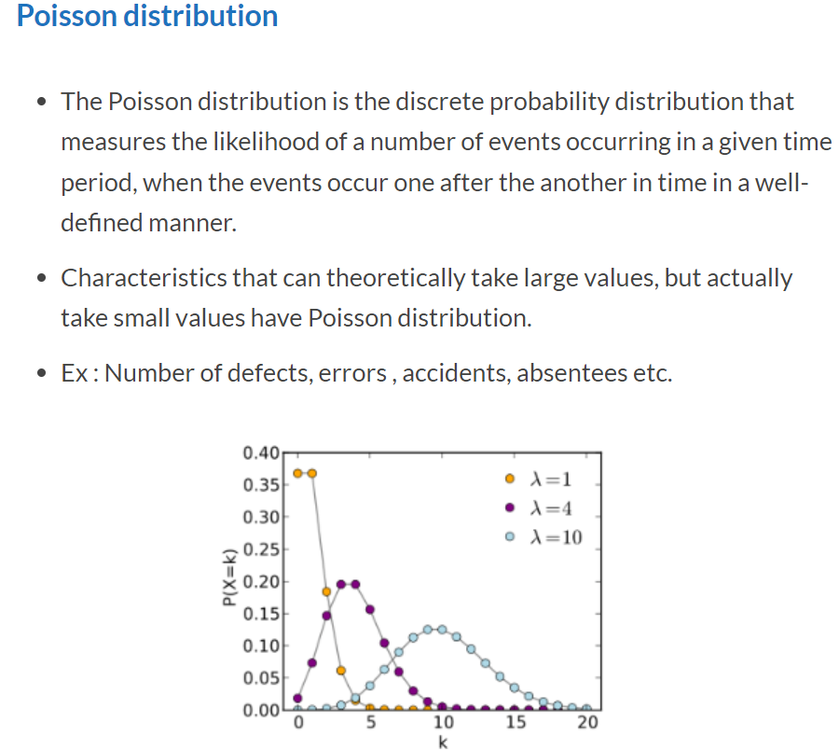

Slide 15
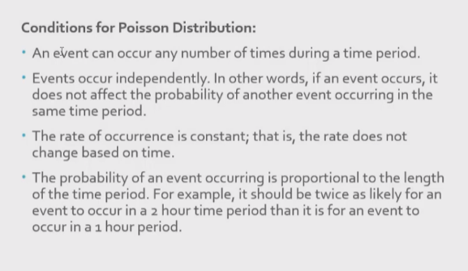

Slide 16
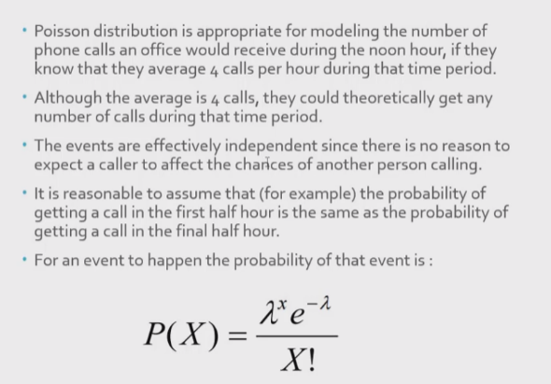

Slide 17
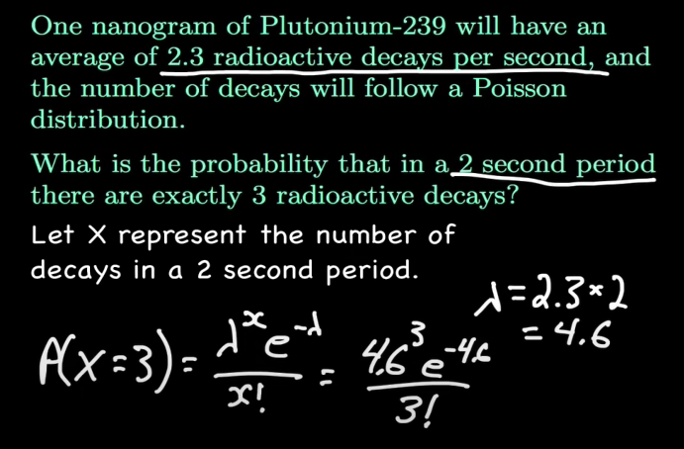

Slide 18
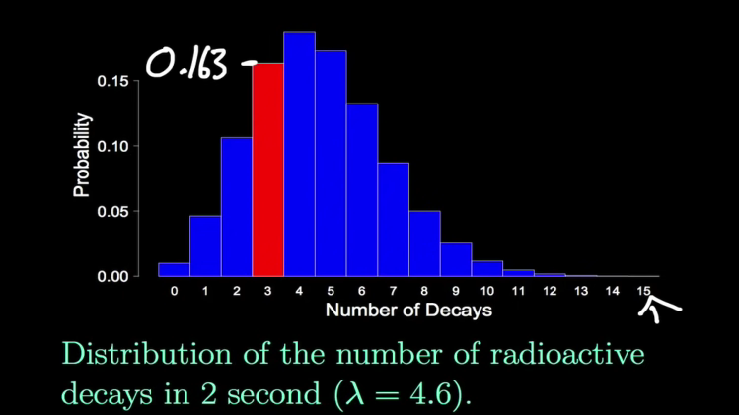

Slide 19
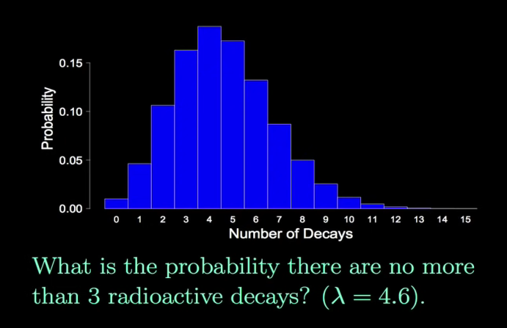

Slide 20
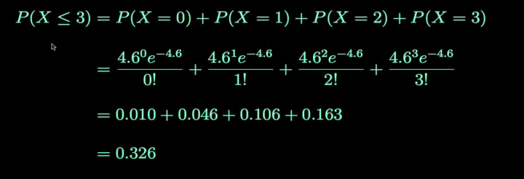

Slide 21
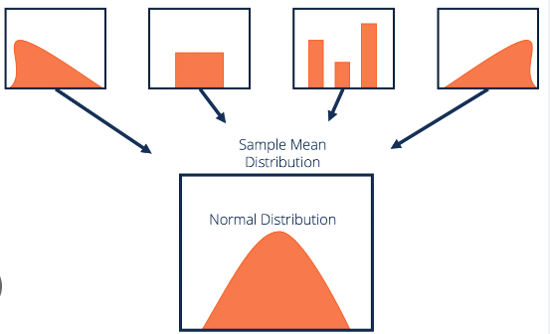
Central Limit Theorem

Slide 22
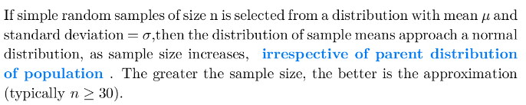
Central Limit Theorem
https://www.youtube.com/watch?v=YAlJCEDH2uY

Slide 23
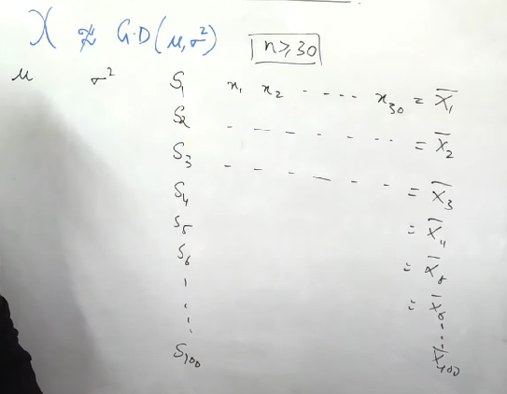
Central Limit Theorem

Slide 24
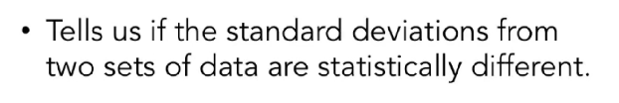
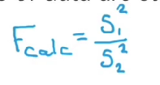
F Test
A Statistical F Test uses an F Statistic to compare two variances, s1 and s2, by dividing them. The result is always a positive number (because variances are always positive).

Slide 25
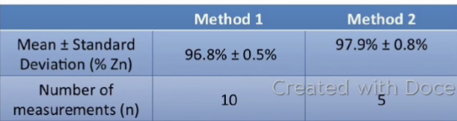
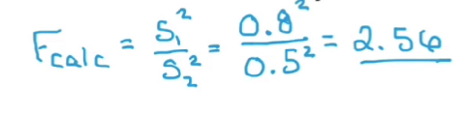
F Test
https://users.sussex.ac.uk/~grahamh/RM1web/F-ratio%20table%202005.pdf

Slide 26
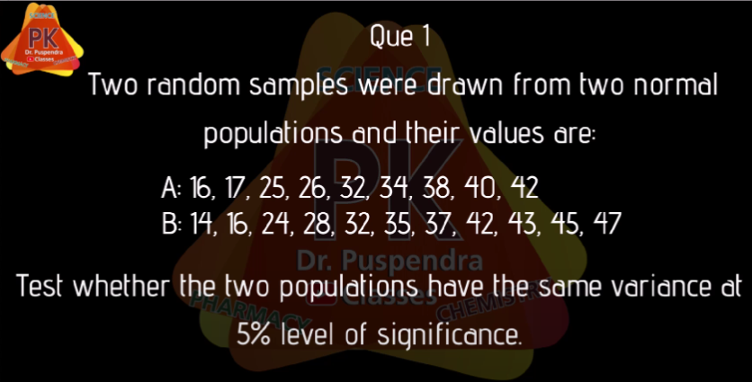

Slide 27
